Slide 1


Social Networking
The Dangers and
How to Protect Yourself

Slide 2
What is Social Networking?

Slide 3
What It Is
The usage of Social Media to interact with others typically by using:
Pictures
Texts
Videos

Slide 4
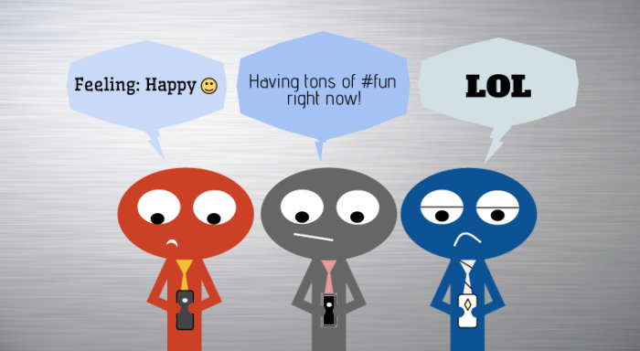

Slide 5









Social Media

Slide 6




Top 5 most Commonly Used
Facebook- 900 000 000 Users
Twitter- 310 000 000 Users
LinkedIn- 255 000 000 Users
Pinterest- 250 000 000 Users

Slide 7
General Statistics
Over 70% of all internet users are now active on social media
18-29 year olds have a 90% usage
The 30-49 bracket sits at over 70%

Slide 8
General Statistics
60% of 50 to 60 year olds are active on social media
Over 70% of users access social media from a mobile device.

Slide 9
Over 70% of all internet users are now active on social media

Slide 10
The Dangers

Slide 11
Dangers
Your identity may be at risk
Puts your accounts at risk
Allows people to stalk you
Gives burglars opportunities to raid your house

Slide 12
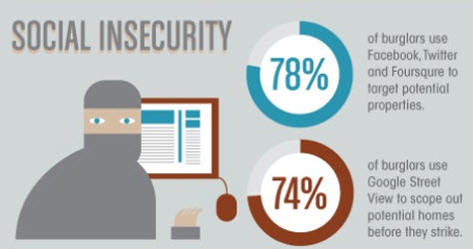

Slide 13
Keeping Out of Trouble

Slide 14
Avoid posting specific travel plans. Never post when, where, or how long you’ll be gone
Wait until you are home to post pictures to a vacation album

Slide 15
Have strong passwords
Be careful with status updates
Don’t reveal your location
Be aware of third party apps

Slide 16
Consequences

Slide 17
Posting inappropriately may…
Cause your job to be at stake
Result in a criminal record and/or imprisonment/fines

Slide 18
Bibliography
http://clearwebservices.com/social-media/how-does-social-media-work/
http://www.directtrafficmedia.co.uk/blog/how-social-media-can-help-or-hinder-home-security
http://jonnegroni.com/2013/05/24/social-media-is-making-us-more-insecure/
http://www.pacific.edu/Campus-Life/Safety-and-Conduct/Online-Social-Networking-Dangers-and-Benefits-.html
http://www.mediabistro.com/alltwitter/5-social-media-threats_b51841
http://www.jeffbullas.com/2014/01/17/20-social-media-facts-and-statistics-you-should-know-in-2014/

